Slide 1


Unit 3 Lesson 2
Counting to 20

Slide 2

Let’s sing!

Slide 3
01
We practice!

Slide 4
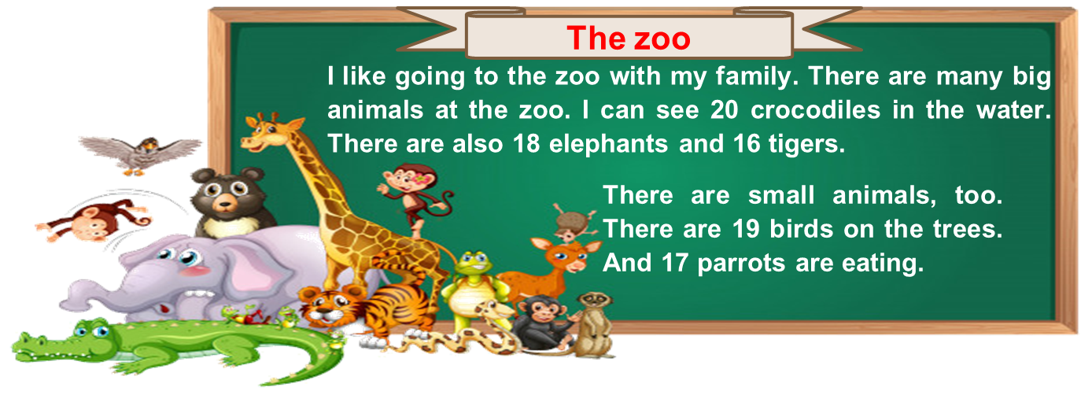
5. Read and match.
Match

Slide 5
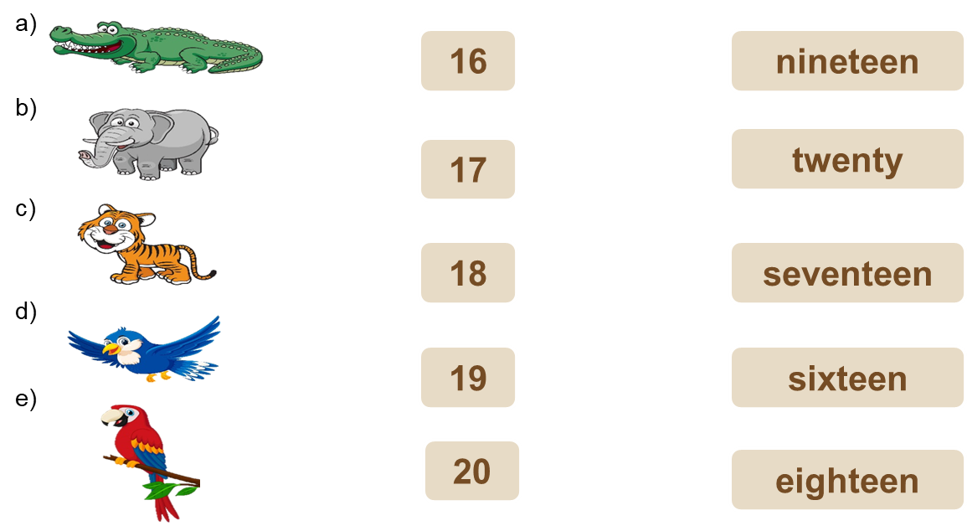
5. Read and match.
Read

Slide 6

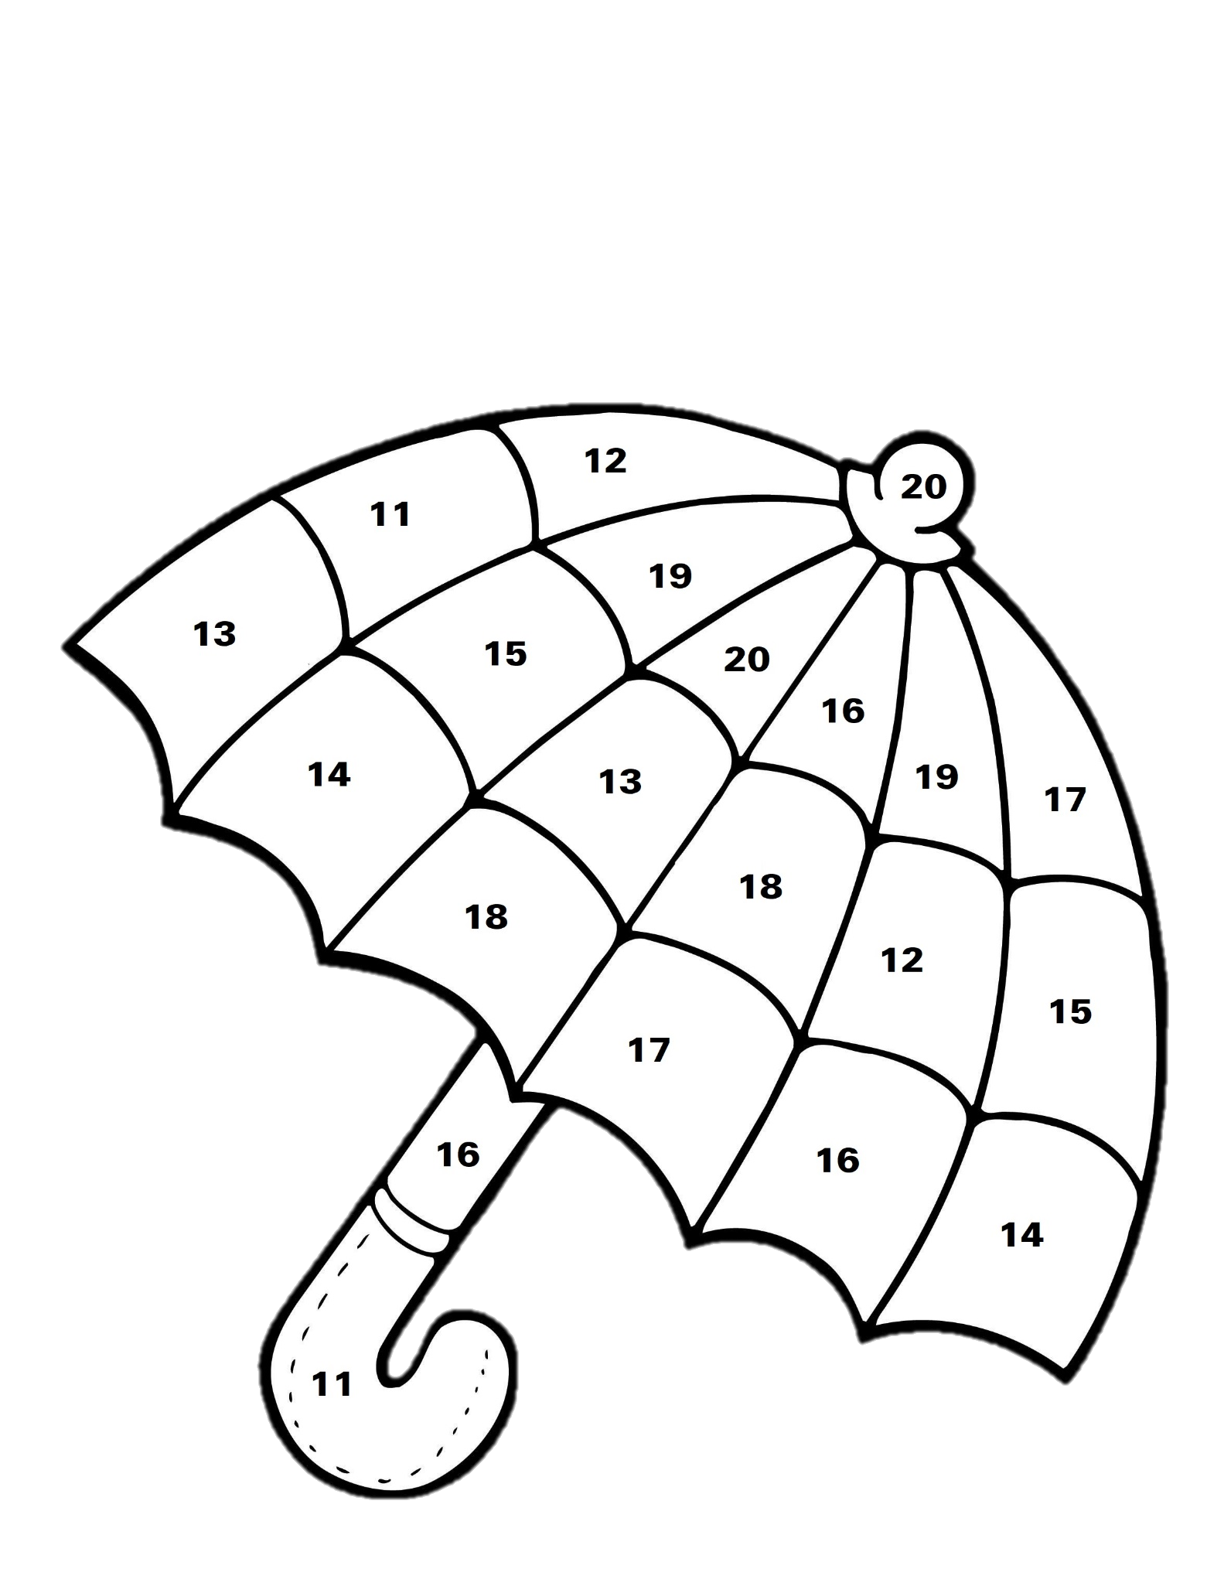
6. Color the picture.
eleven
twelve
thirteen
fourteen
fifteen
sixteen
seventeen
eighteen
nineteen
twenty

Slide 7
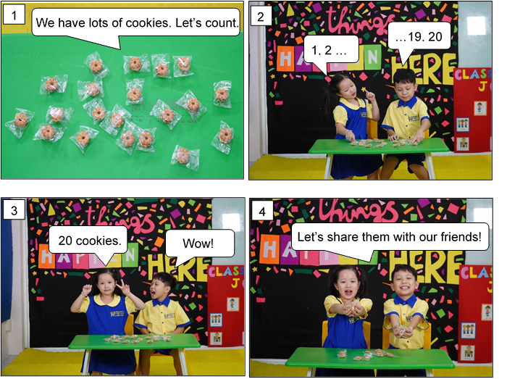

Our cookies
7. Listen and repeat.
Value: Share with friends

Slide 8
Let’s play!

Slide 9

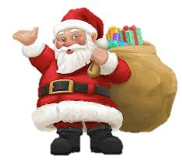



Instruction: Split class into 5 teams. Raise your hand quick to answer for your team. Count the objects on the slide and pick the correct number. The team with the most correct answers wins.
A Letter To Santa Claus

Slide 10
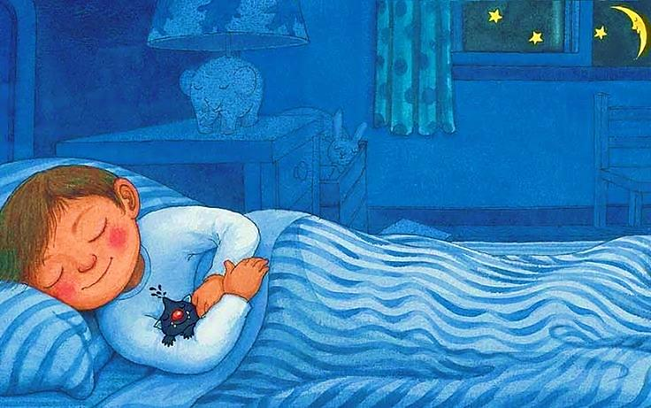


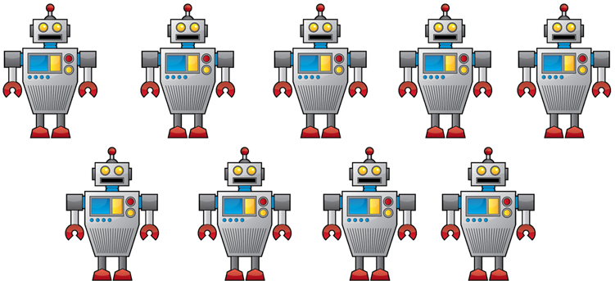
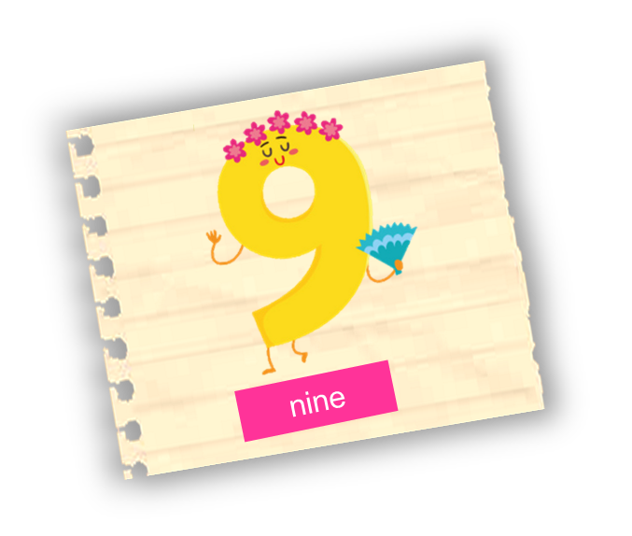
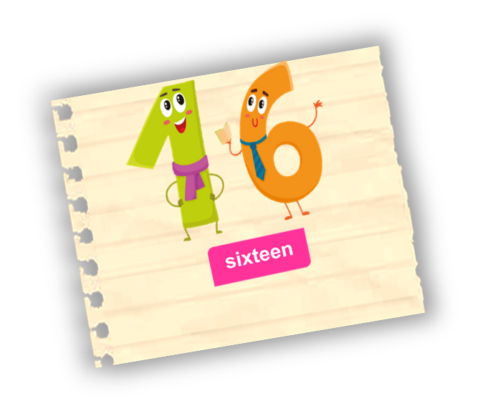
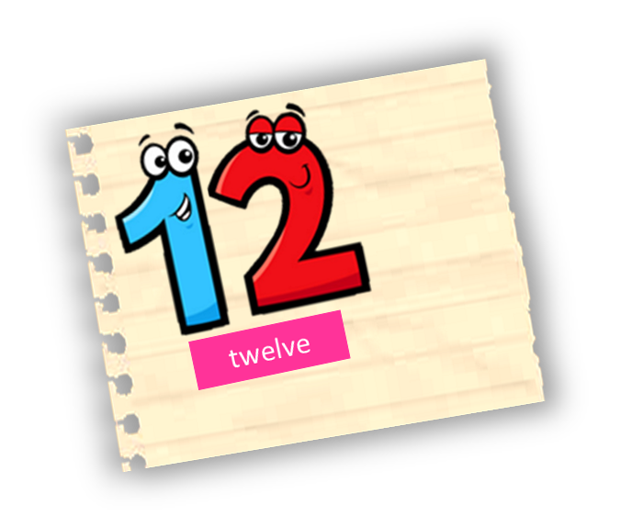

How many robots are there?
There are nine robots.
Next

Slide 11
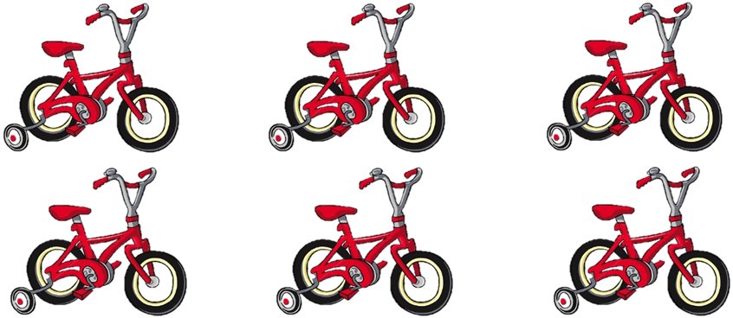
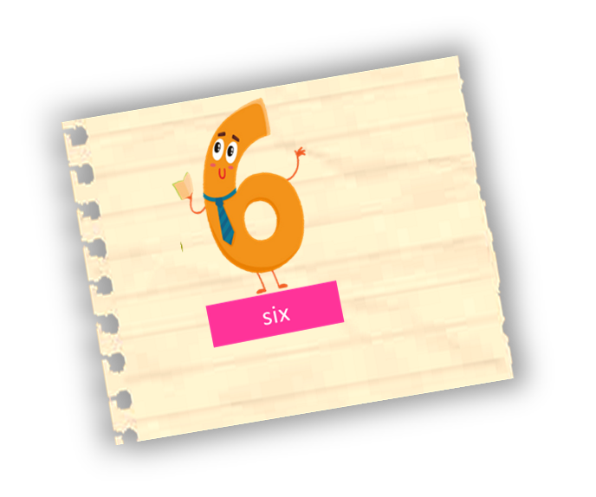
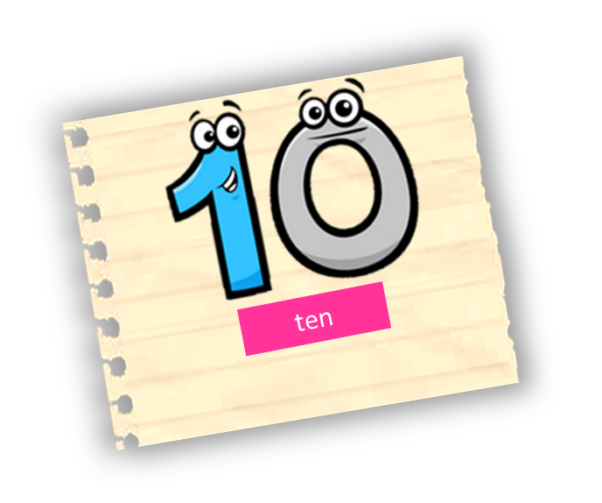
How many bicycles are there?
There are six bicycles.
Next

Slide 12

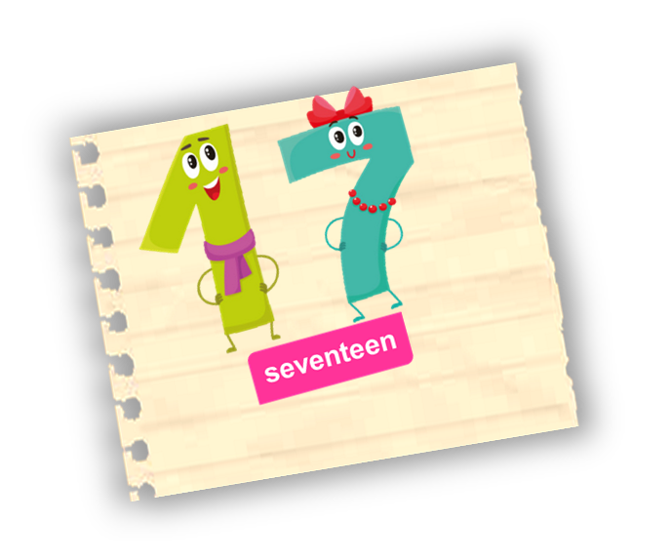
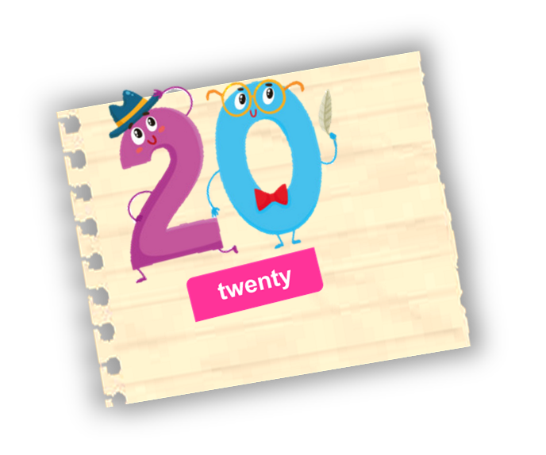
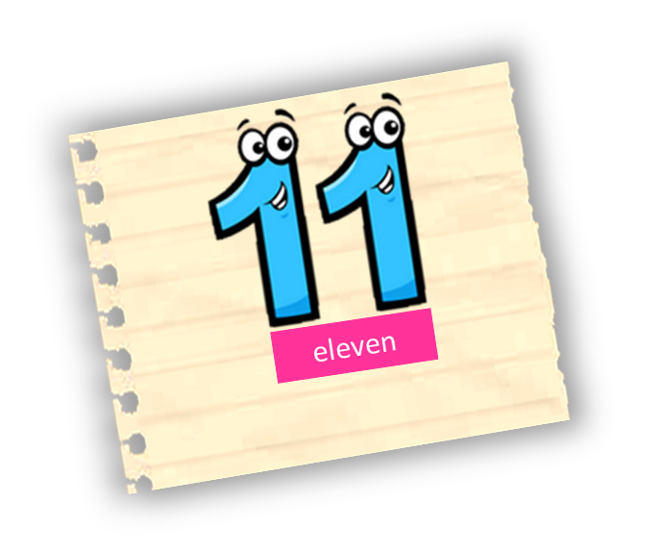
There are eleven ducks.
How many ducks are there?
Next

Slide 13
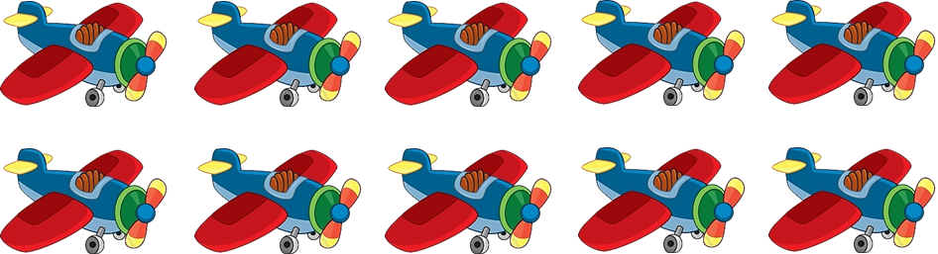
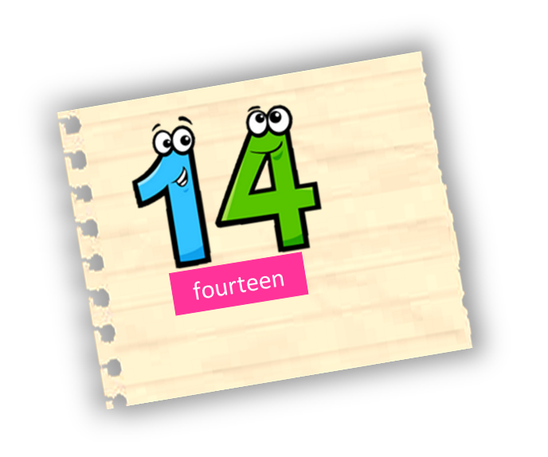
There are ten planes.
How many planes are there?
Next

Slide 14
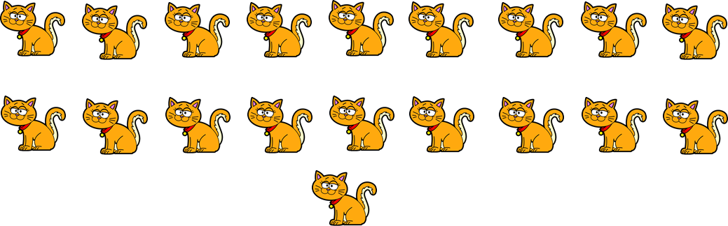
There are twenty cats.
How many cats are there?
Next

Slide 15
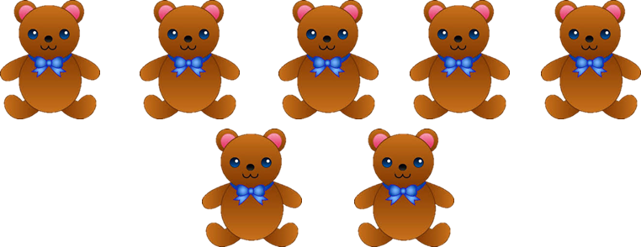
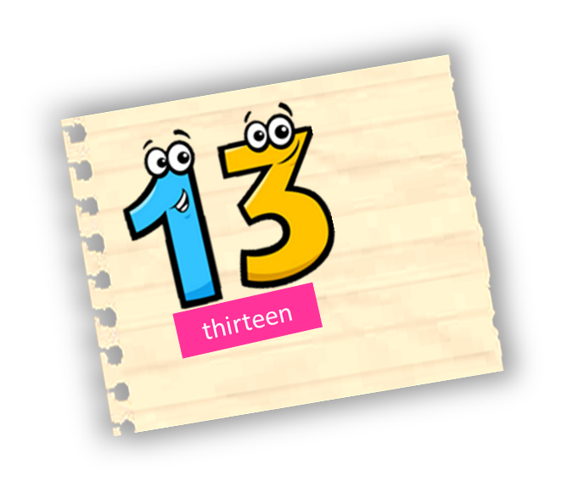
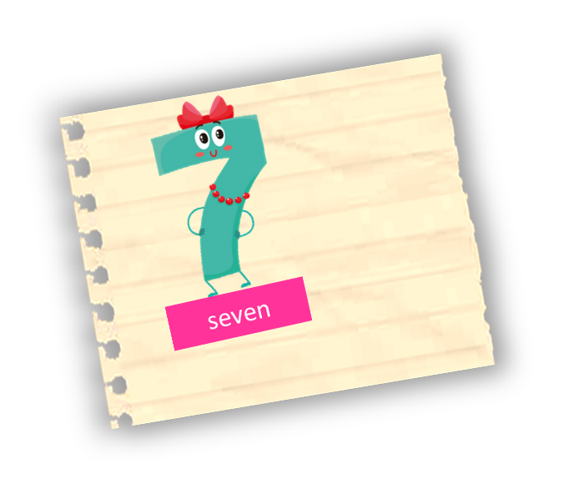
There are seven teddy bears.
How many teddy bears are there?
Next

Slide 16

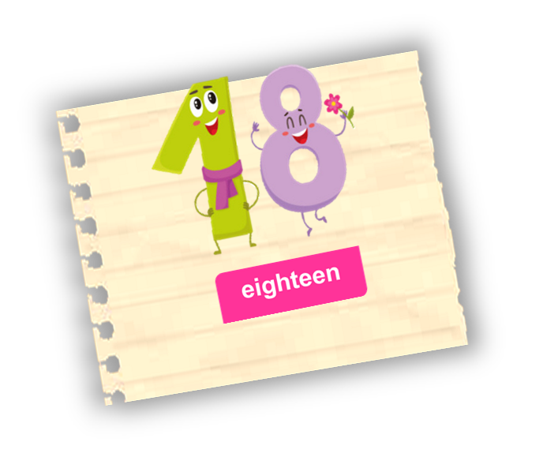
There are twelve fish.
How many fish are there?
Next

Slide 17

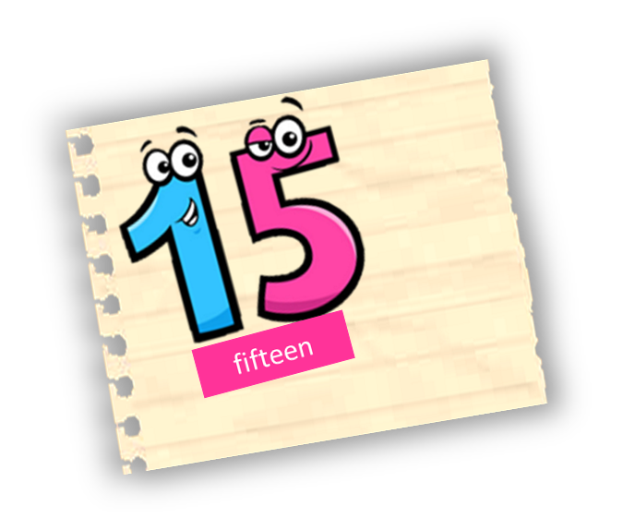
There are thirteen keys.
How many keys are there?
Next

Slide 18
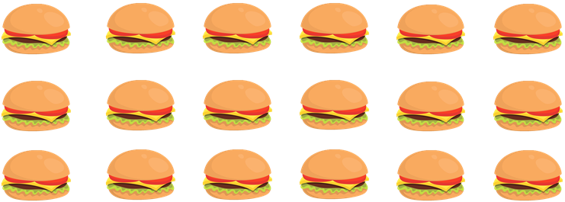
How many hamburgers are there?
There are eighteen hamburgers.
Next

Slide 19
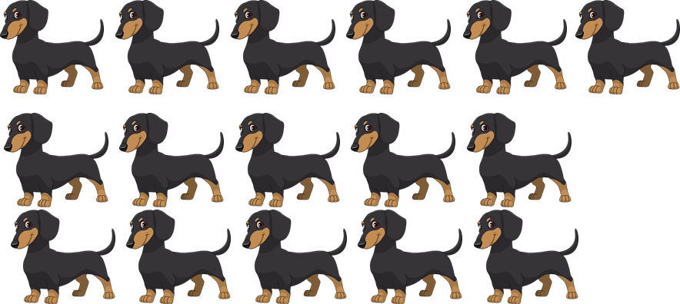
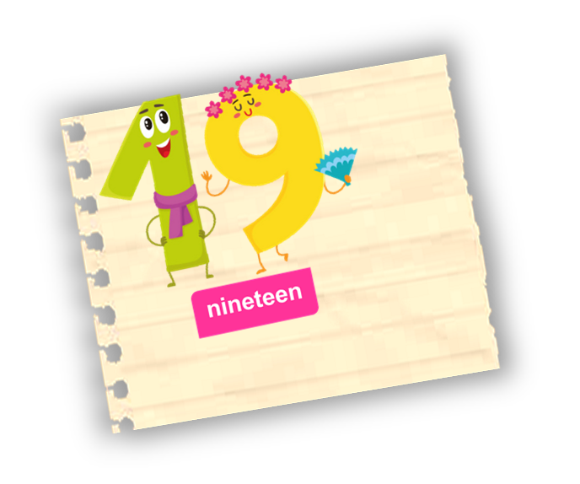
How many dogs are there?
There are sixteen dogs.
Next

Slide 20
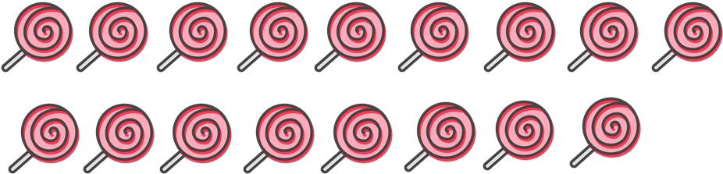
There are seventeen candies.
How many candies are there?
Next

Slide 21
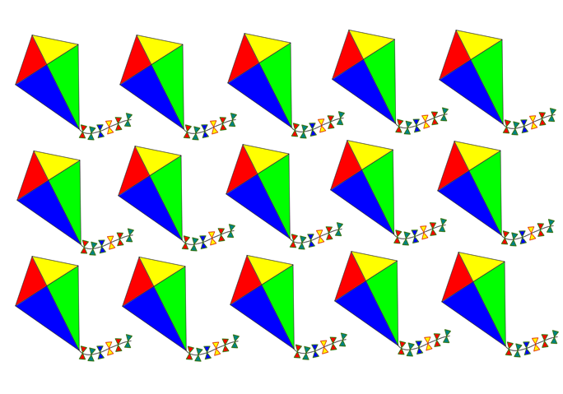
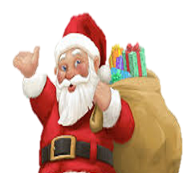
There are fifteen kites.
How many kites are there?
Next

Slide 22
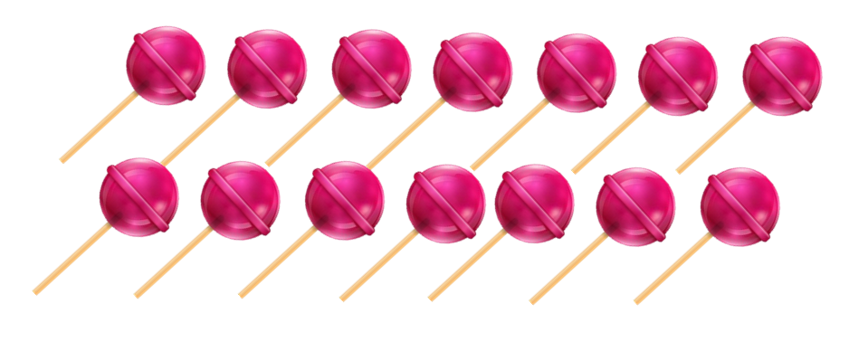
There are fourteen lollipops.
How many lollipops are there?
Next

Slide 23
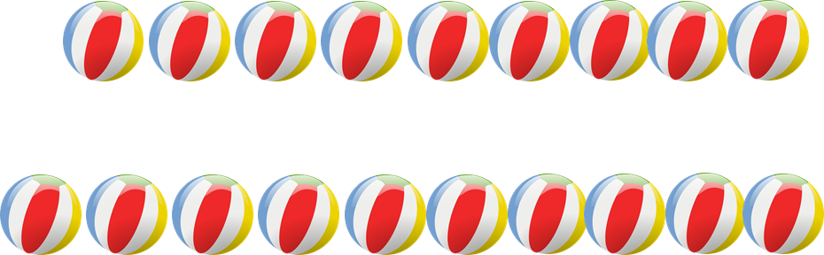
There are nineteen balls.
How many balls are there?
Next

Slide 24

Merry Early Christmas!

Slide 25





Thanks!

